Slide 1
Note Storage Database
Designed and built by Tony Rocha

Slide 2

User Story:
“I am a student, and would like to store my notes in a convenient place, as well as be able to quickly search through them.”

Slide 3
User Story:
“I am a student, and would like to store my notes in a convenient place, as well as be able to quickly search through them.”

Slide 4
3 Tier Split Workflow:
Presentation Layer
Business Layer
Database Layer

Slide 5

Presentation Layer

Slide 6
Web Hosted Application
Self hosted on owned hardware (which makes it free to run!)
Built on the Aurelia Framework utilizing the Typescript transpiler, and the LESS preprocessor

Slide 7
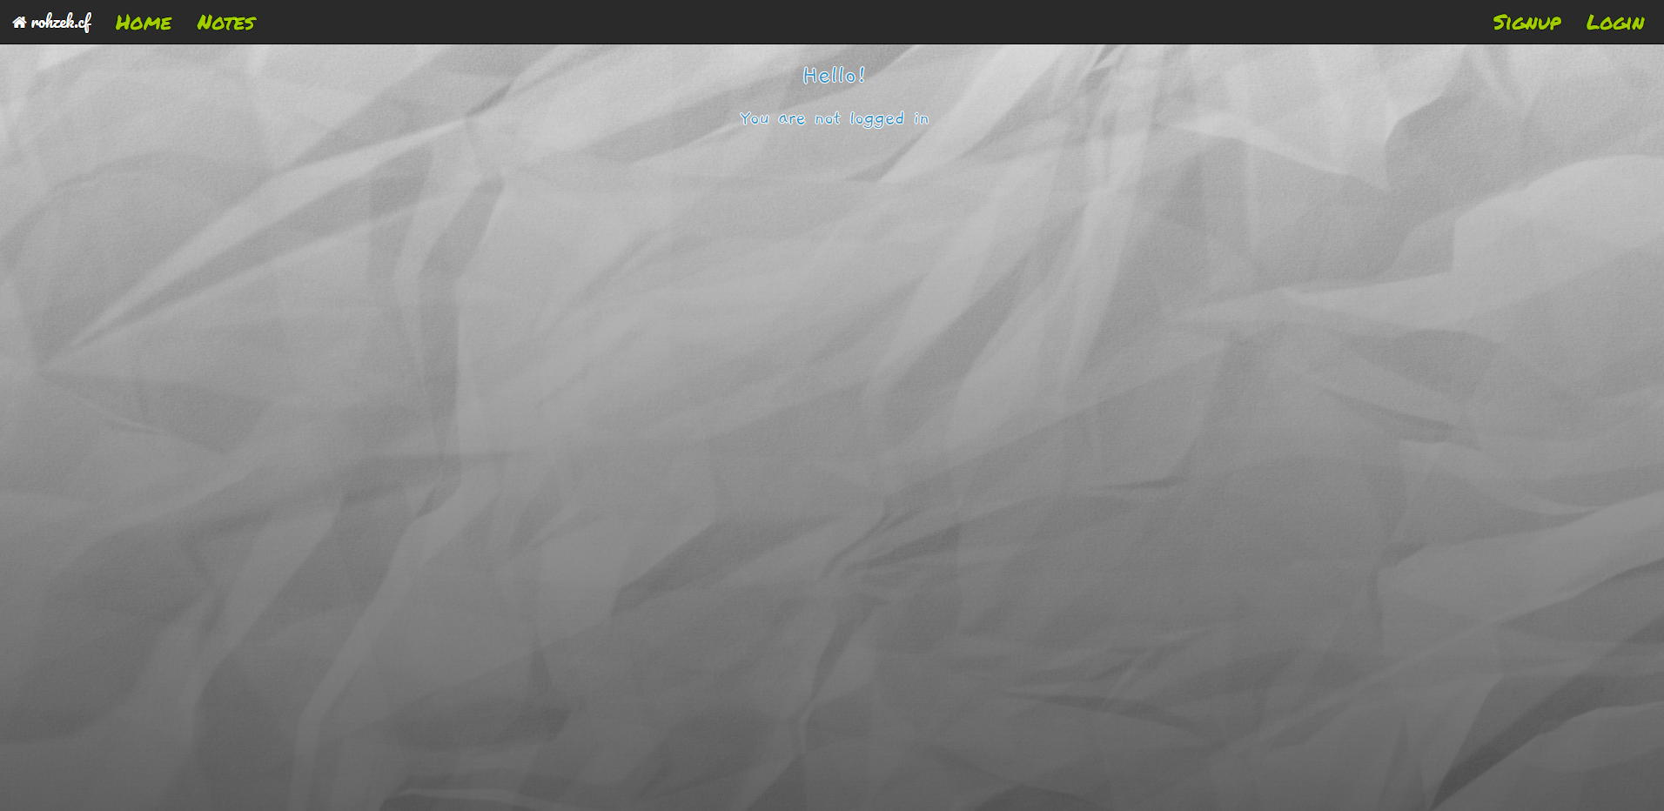

Slide 8
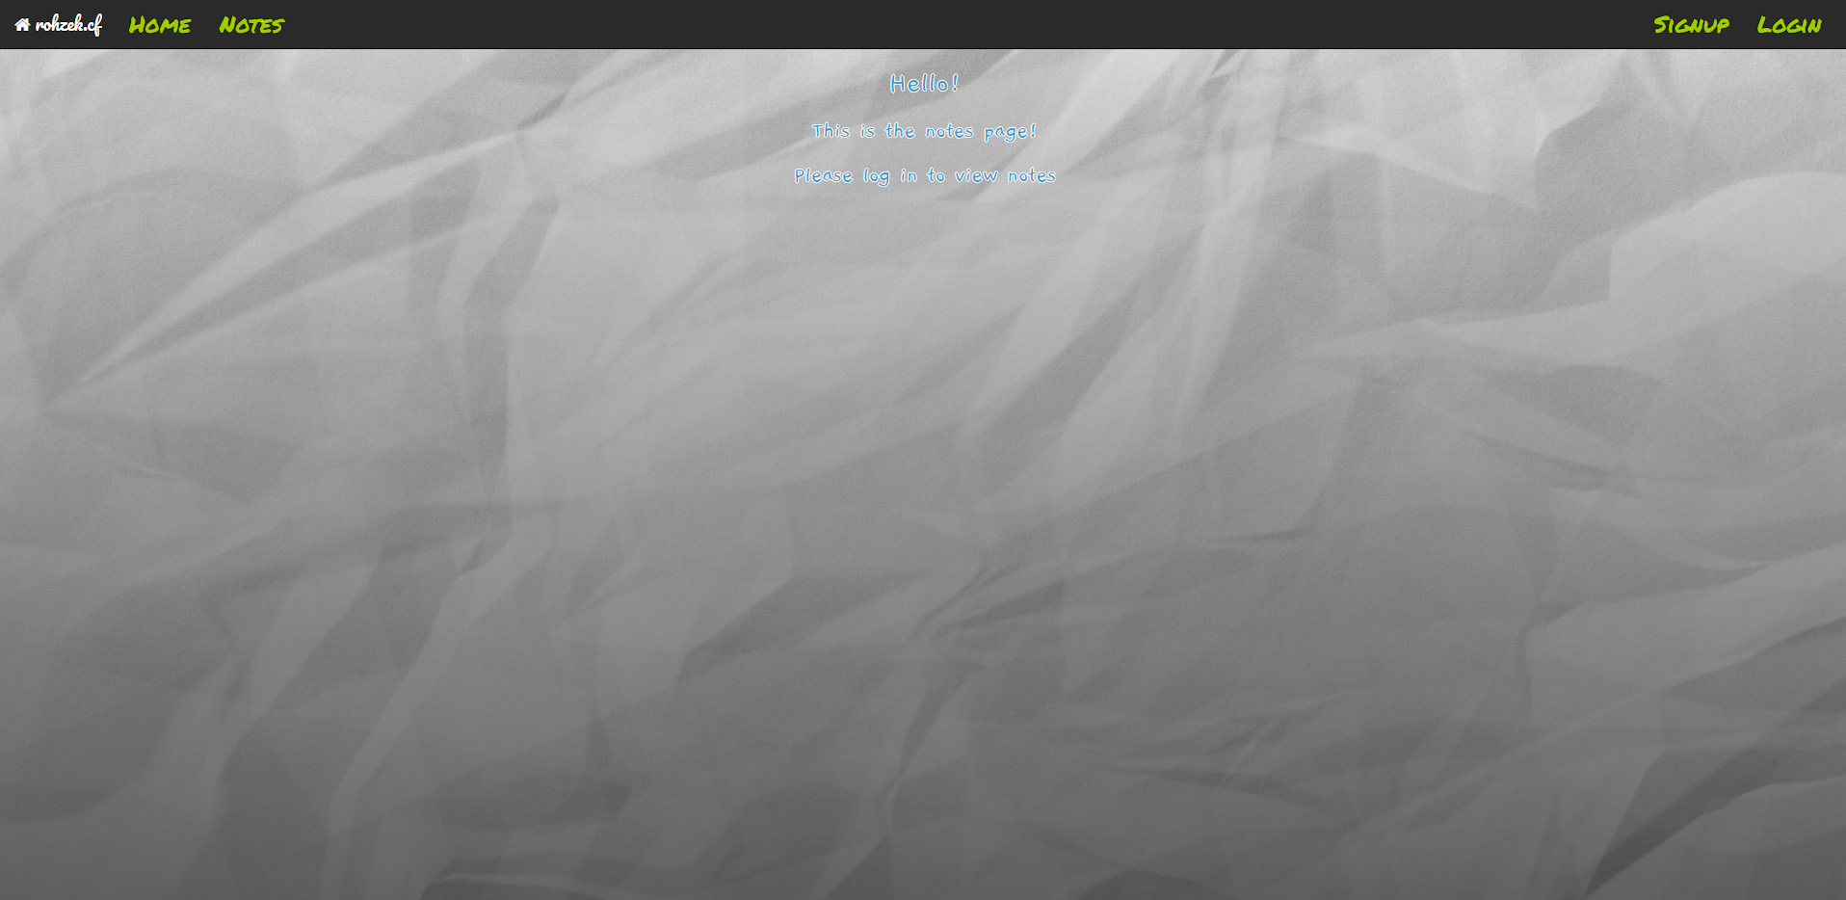

Slide 9
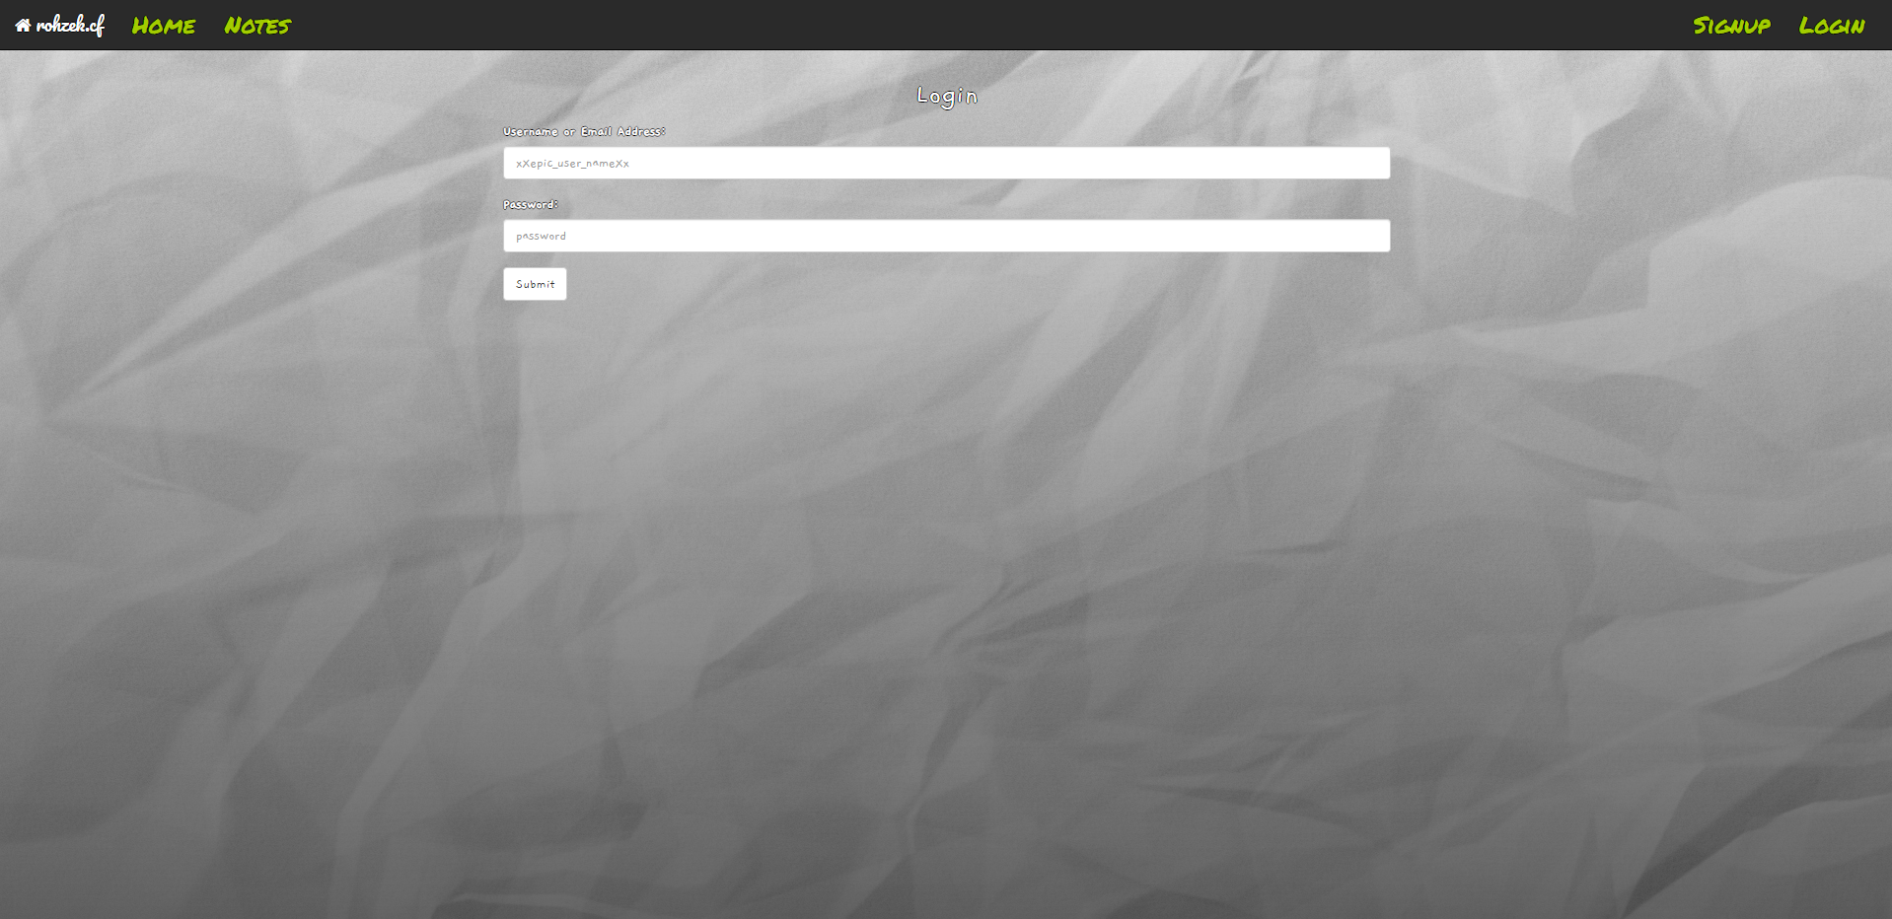

Slide 10
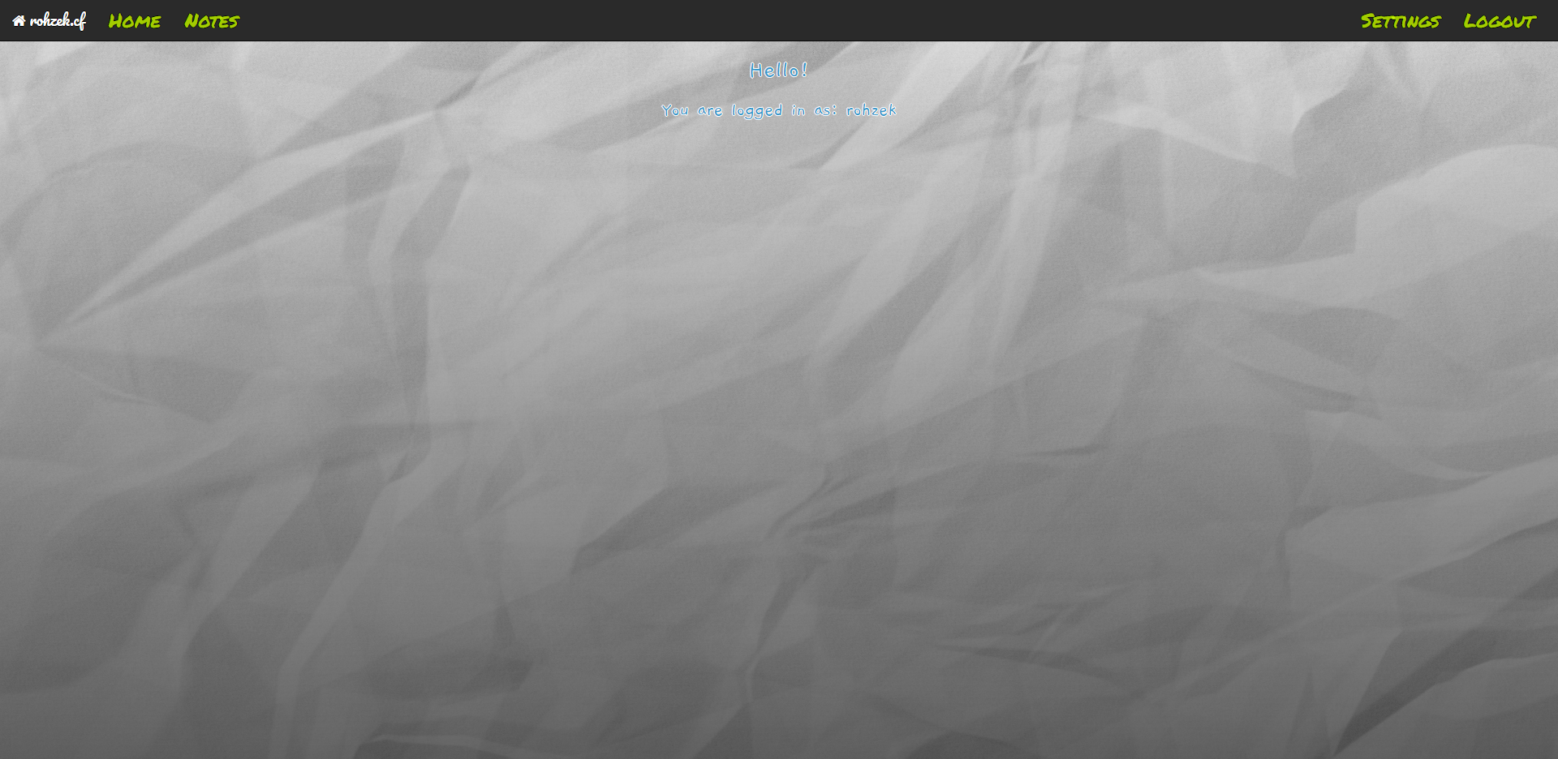

Slide 11
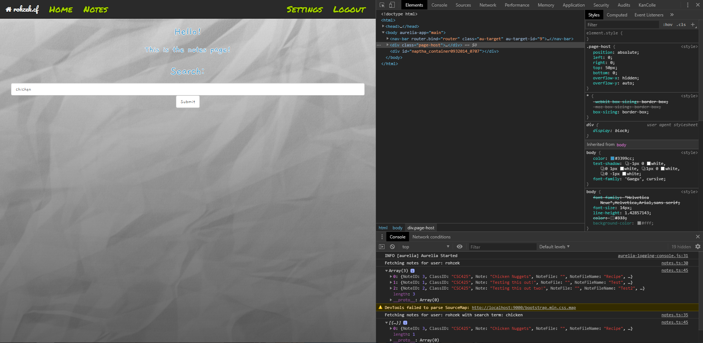

Slide 12

Business Layer

Slide 13
ASP.NET Core Web API
Self hosted on owned hardware (which makes it free to run!)
Written in C#
Uses Entity Framework Core to interact with Database

Slide 14
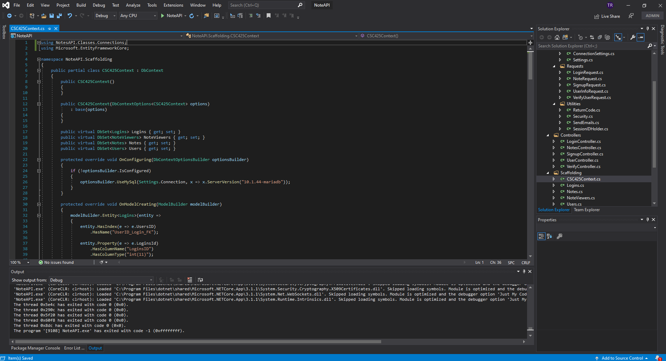

Slide 15
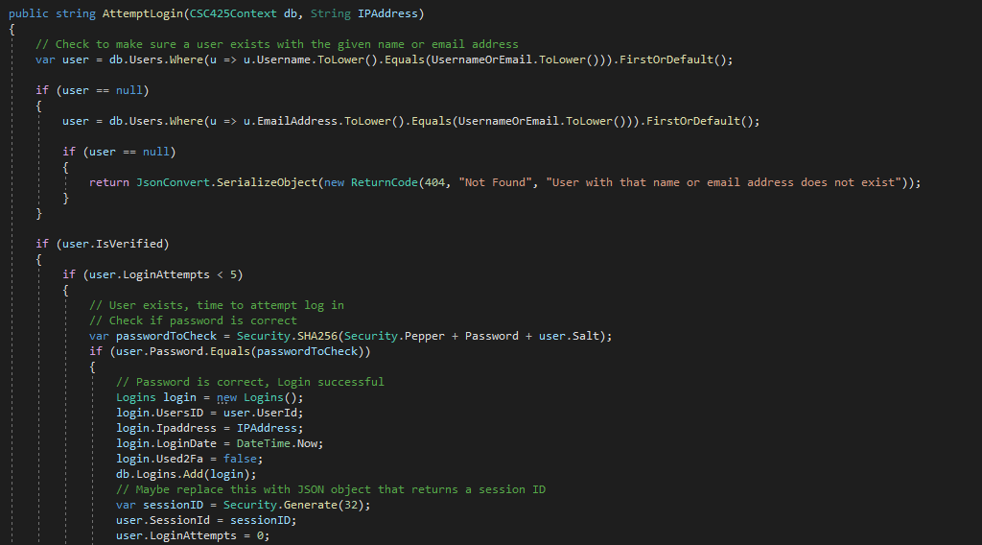

Slide 16
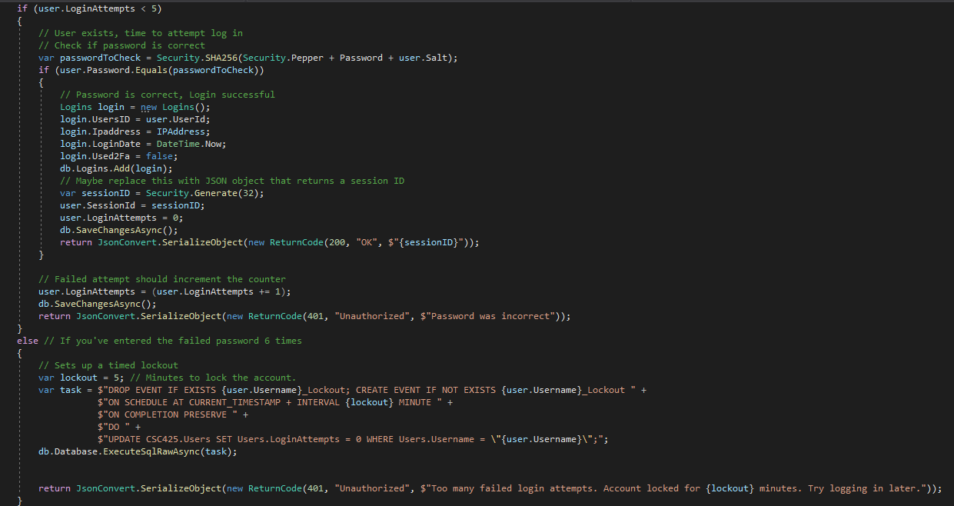

Slide 17

Database Layer

Slide 18
MariaDB
Self hosted on owned hardware (which makes it free to run!)
MariaDB is a fork of MySQL which is familiar and highly documented
High data security, scalability, and performance
Is useable with CLI, but also works with Oracle’s own MySQL Workbench GUI

Slide 19
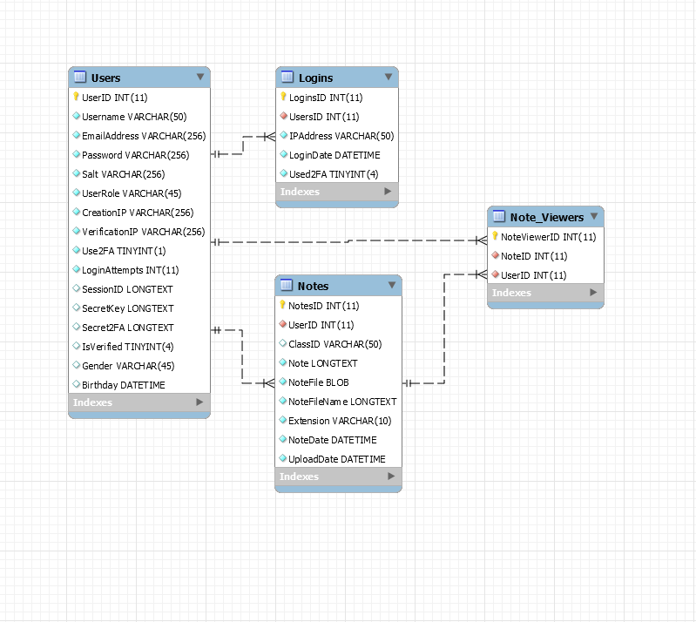
It all started with a diagram

Slide 21
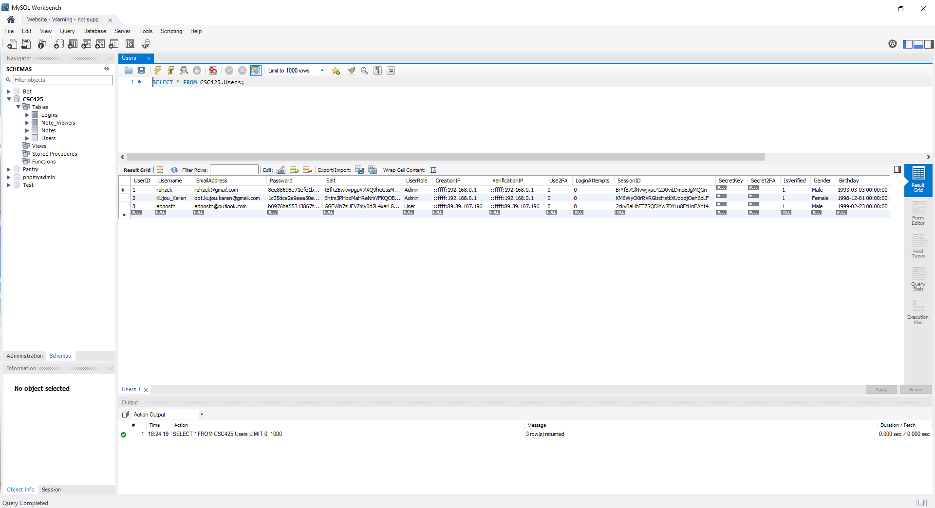

Slide 22
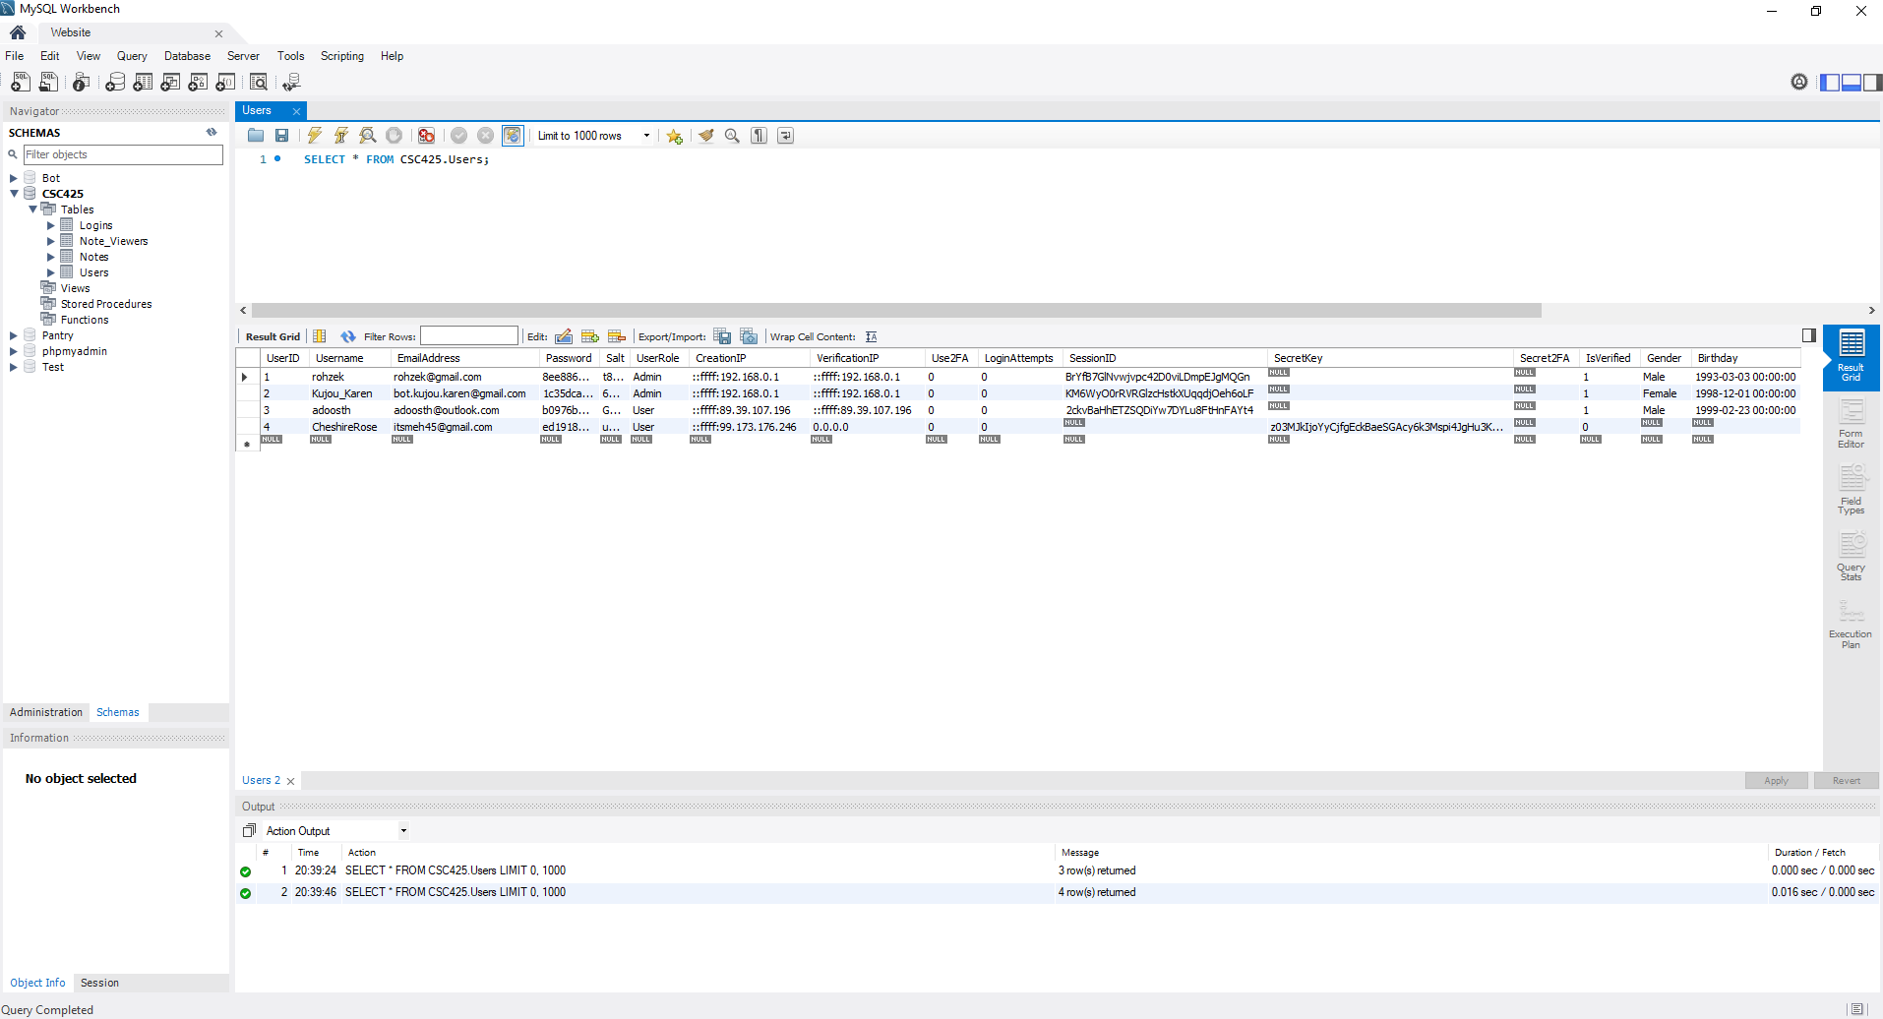

Slide 23
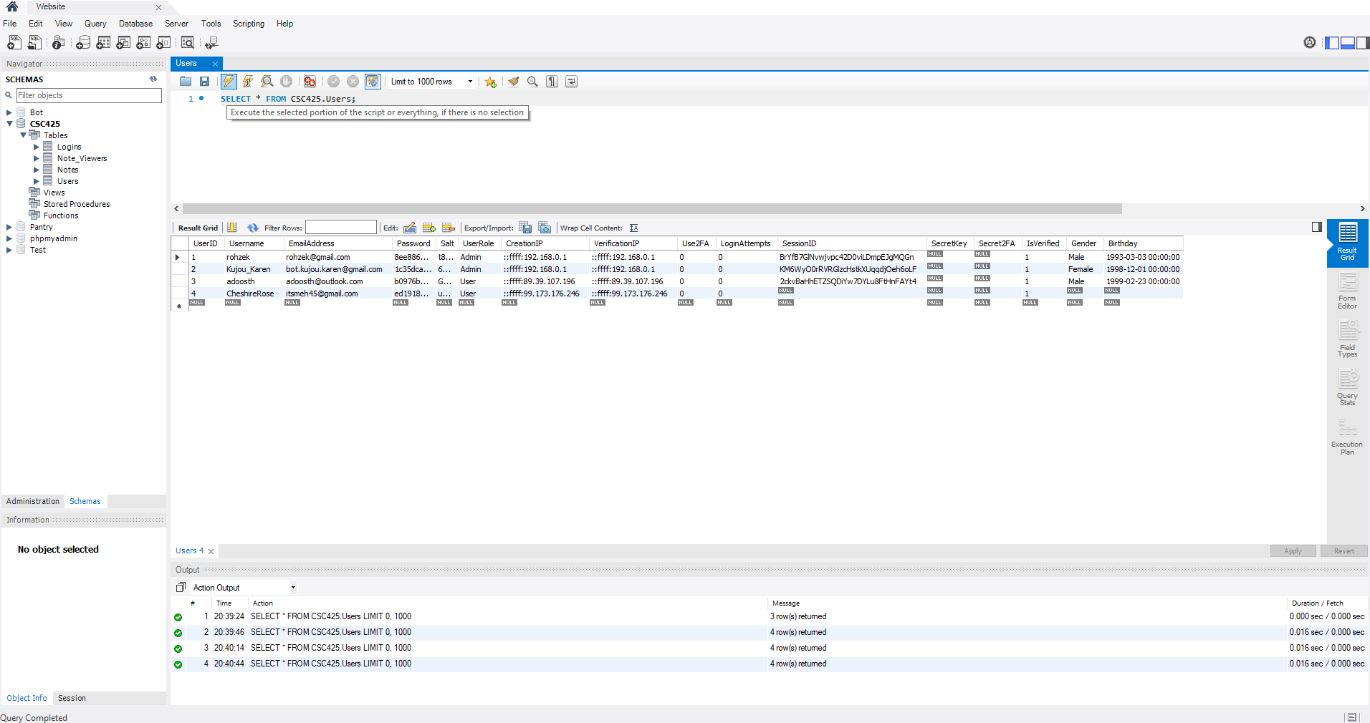

Slide 24
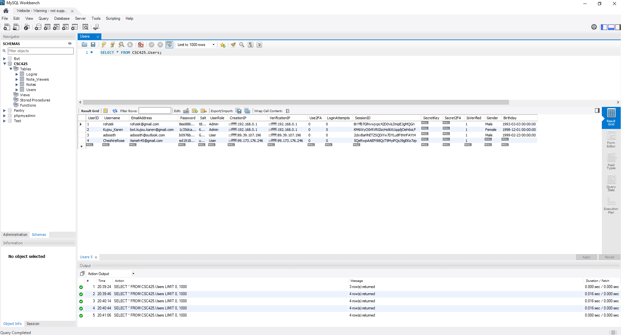

Slide 25

The Hardware

Slide 26
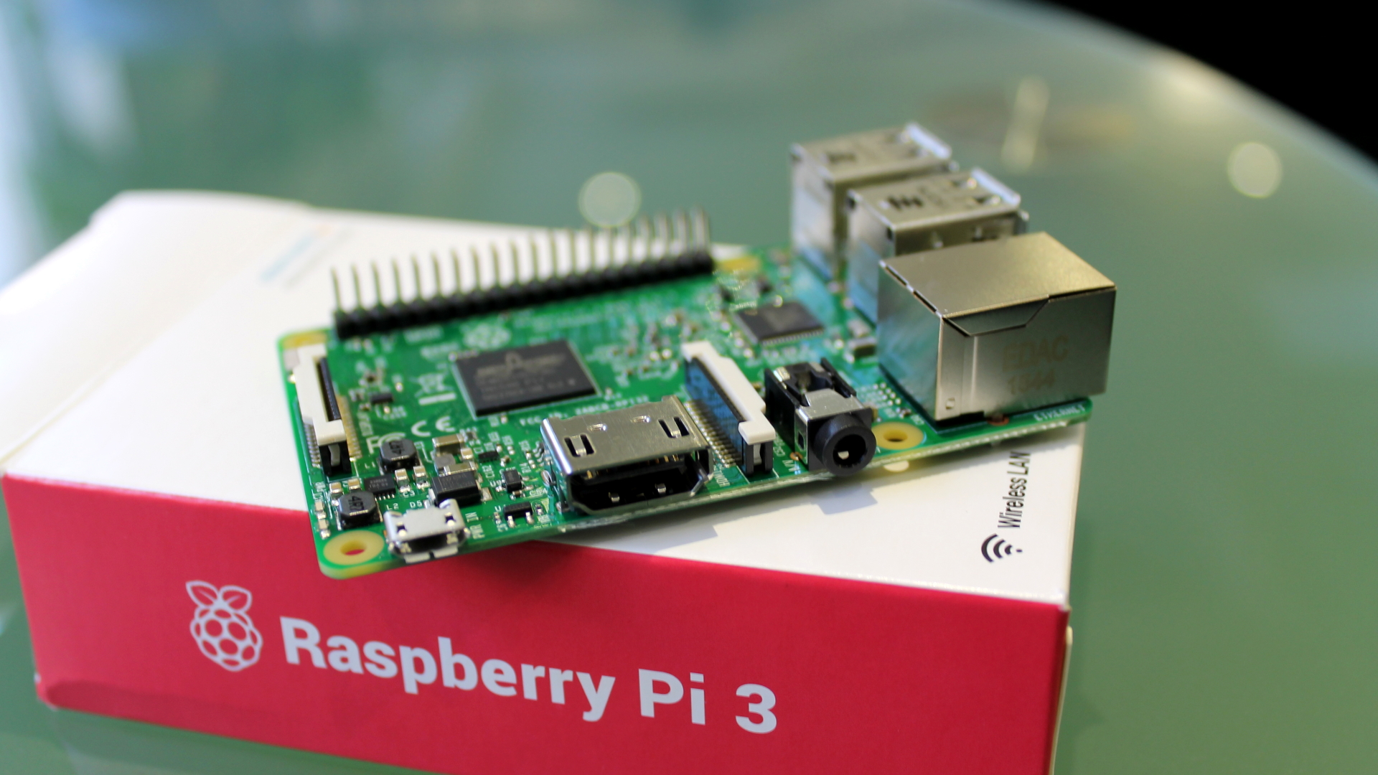
All self-hosting is done on 2 Raspberry Pi 3B+’s

Slide 27
Thank you. Any questions?

Slide 28
End

